Slide 1
USER GUIDE 4.2 / 6 SEPTEMBER 2026
Simfest Planning Portal
+ PSX.NET.BACARS
From workspace selection to aircraft return
Notes:
Revision 6 September 2026. Sources: local MainForm.cs INIT DATA workflow; AircraftCustodyService.cs seven-day loans and file access; OperationsConsoleForm.cs workspace display; OrchestrationRuntime.cs authoritative turnaround. Earlier screenshots retained as labelled interface examples.

Slide 2
One connected operating workflow
Plan
Build a schedule, assign aircraft and create the operational flight plan.
Brief
Review the OFP, loadsheet, airport briefings and operational information.
Fly
BACARS synchronises the selected aircraft and delivers flight data into PSX.
Record
OOOI, landing, aircraft history and situation state return to the portal.
02
Notes:
Revision 6 September 2026. Sources: local MainForm.cs INIT DATA workflow; AircraftCustodyService.cs seven-day loans and file access; OperationsConsoleForm.cs workspace display; OrchestrationRuntime.cs authoritative turnaround. Earlier screenshots retained as labelled interface examples.

Slide 3
Workspaces decide what you can see and operate
Your private operation
Your own fleet, schedule, crew, gates, planning data and Tech Logs.
A shared operation
Every current member works with the same fleet, schedule and operational records.
Aircraft available to borrow
A global aircraft keeps one identity, Tech Log, files, location and continuous history.
PERSONAL
TEAM
GLOBAL SHELF
03
Notes:
Revision 6 September 2026. Sources: local MainForm.cs INIT DATA workflow; AircraftCustodyService.cs seven-day loans and file access; OperationsConsoleForm.cs workspace display; OrchestrationRuntime.cs authoritative turnaround. Earlier screenshots retained as labelled interface examples.

Slide 4
Global aircraft loans
1 · SELECT
2 · BORROW
3 · RETURN
Choose Personal or Team
The workspace selected in the portal becomes the operating destination.
Take an aircraft from the shelf
The aircraft appears temporarily in that Fleet while retaining its original Global Fleet ID.
Upload the latest state
Return it to the shelf at its accepted location for the next pilot.
04
Notes:
Revision 6 September 2026. Sources: local MainForm.cs INIT DATA workflow; AircraftCustodyService.cs seven-day loans and file access; OperationsConsoleForm.cs workspace display; OrchestrationRuntime.cs authoritative turnaround. Earlier screenshots retained as labelled interface examples.

Slide 5
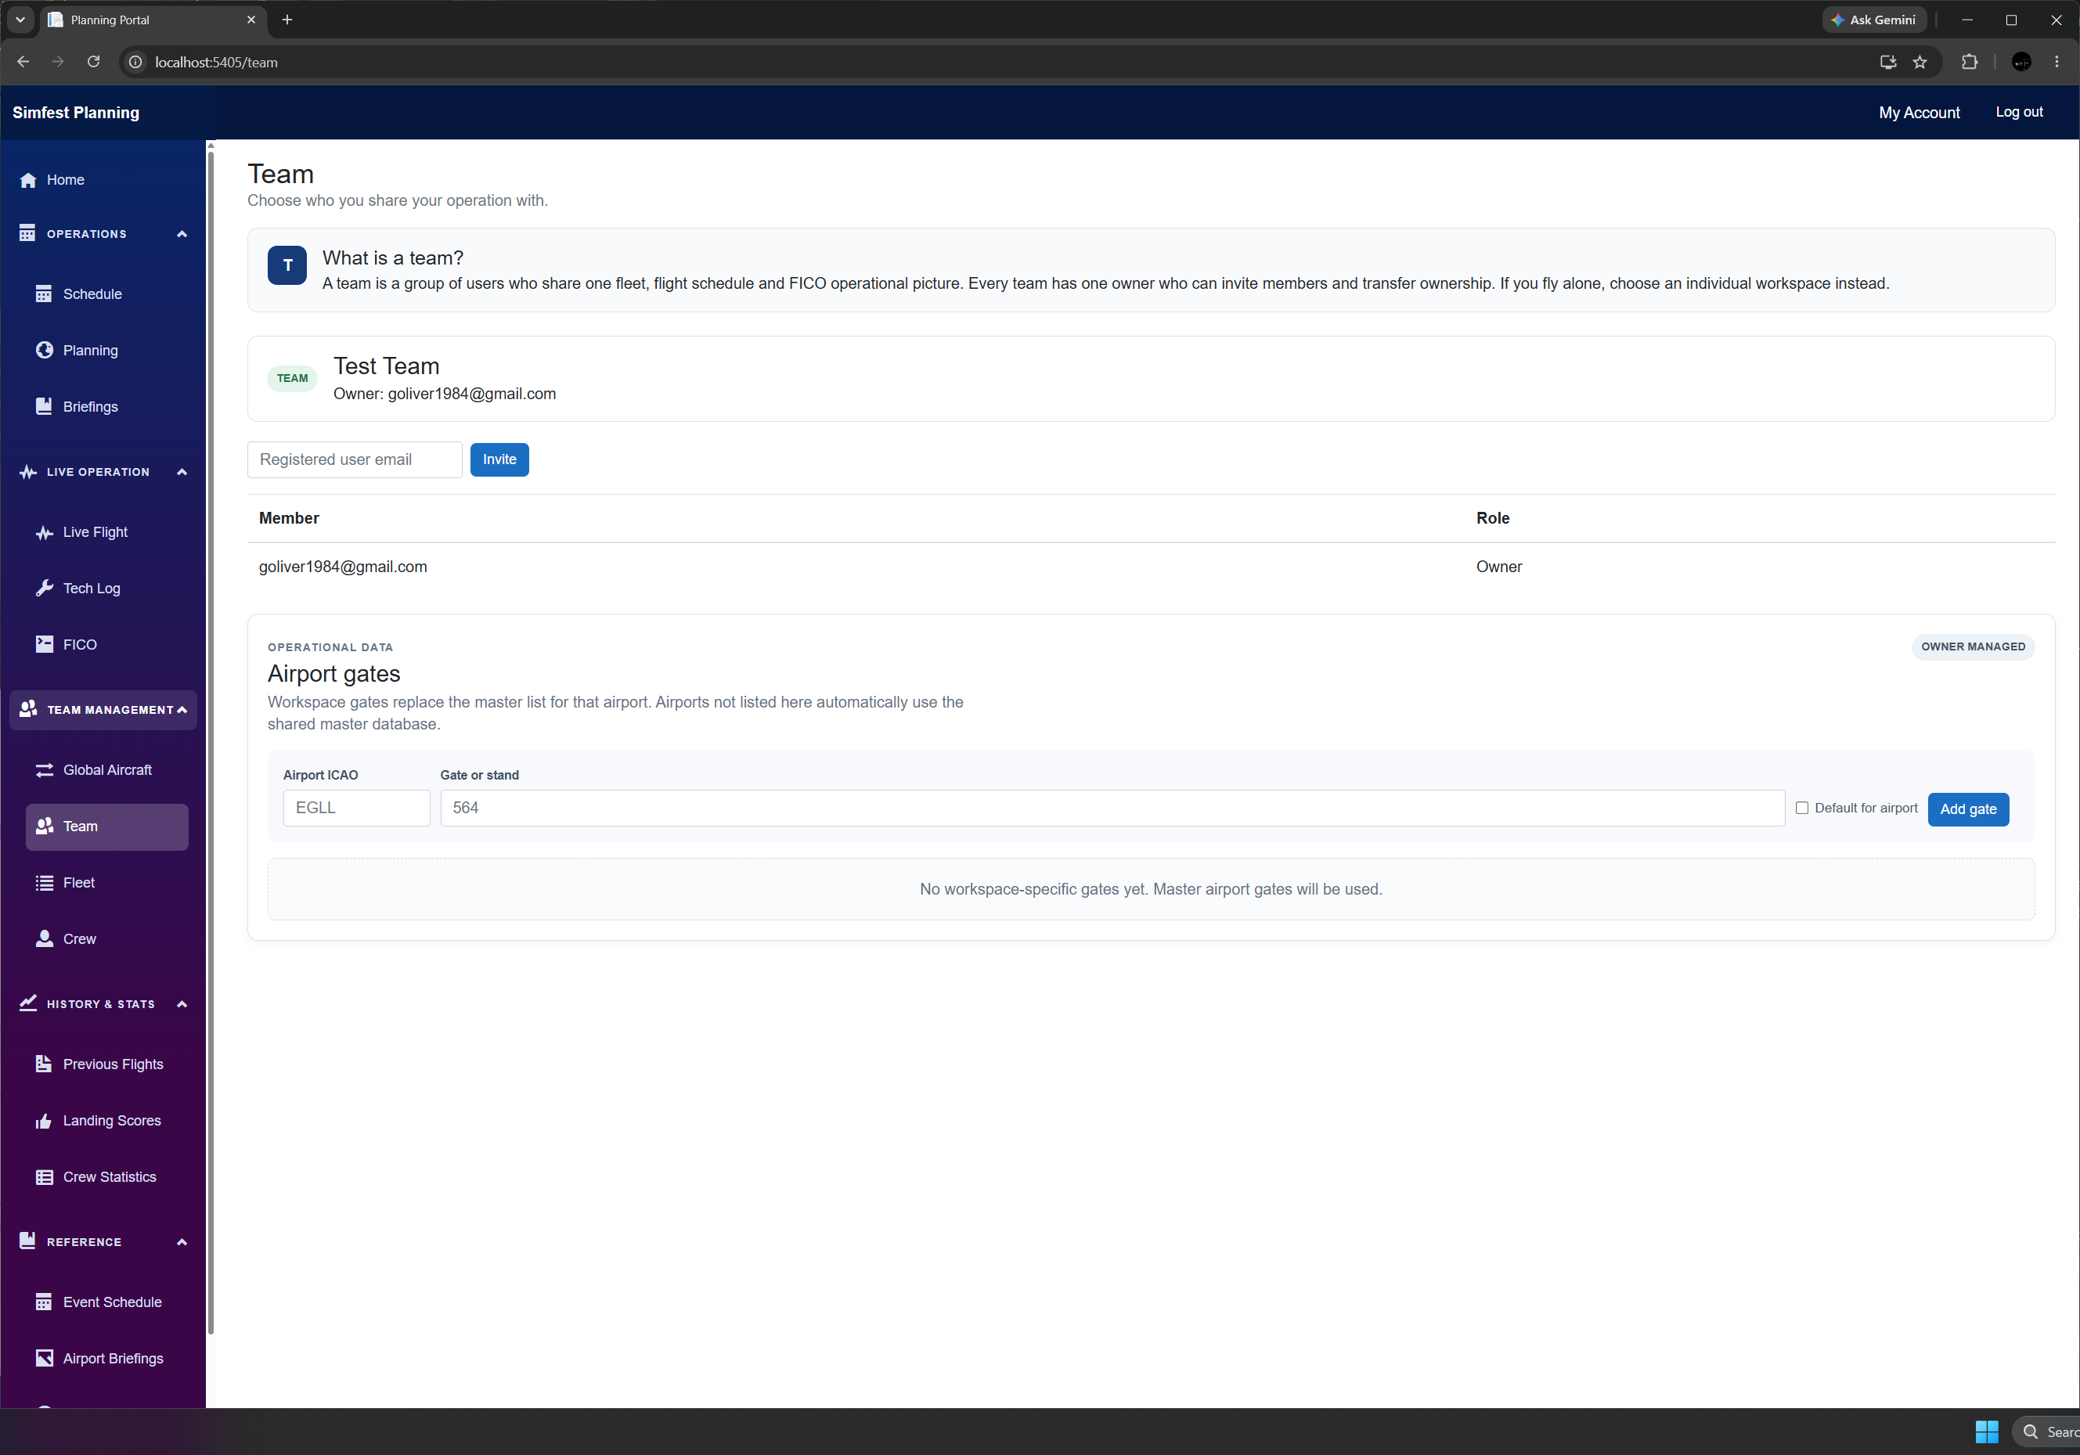
1. Select your workspace
The header selection is authoritative
It controls the Fleet, Schedule and Planning pages — and the aircraft BACARS will offer. Switching workspace does not copy data between Personal and Team.
Earlier interface shown. Labels and layout may differ.
05
Notes:
Revision 6 September 2026. Sources: local MainForm.cs INIT DATA workflow; AircraftCustodyService.cs seven-day loans and file access; OperationsConsoleForm.cs workspace display; OrchestrationRuntime.cs authoritative turnaround. Earlier screenshots retained as labelled interface examples.

Slide 6
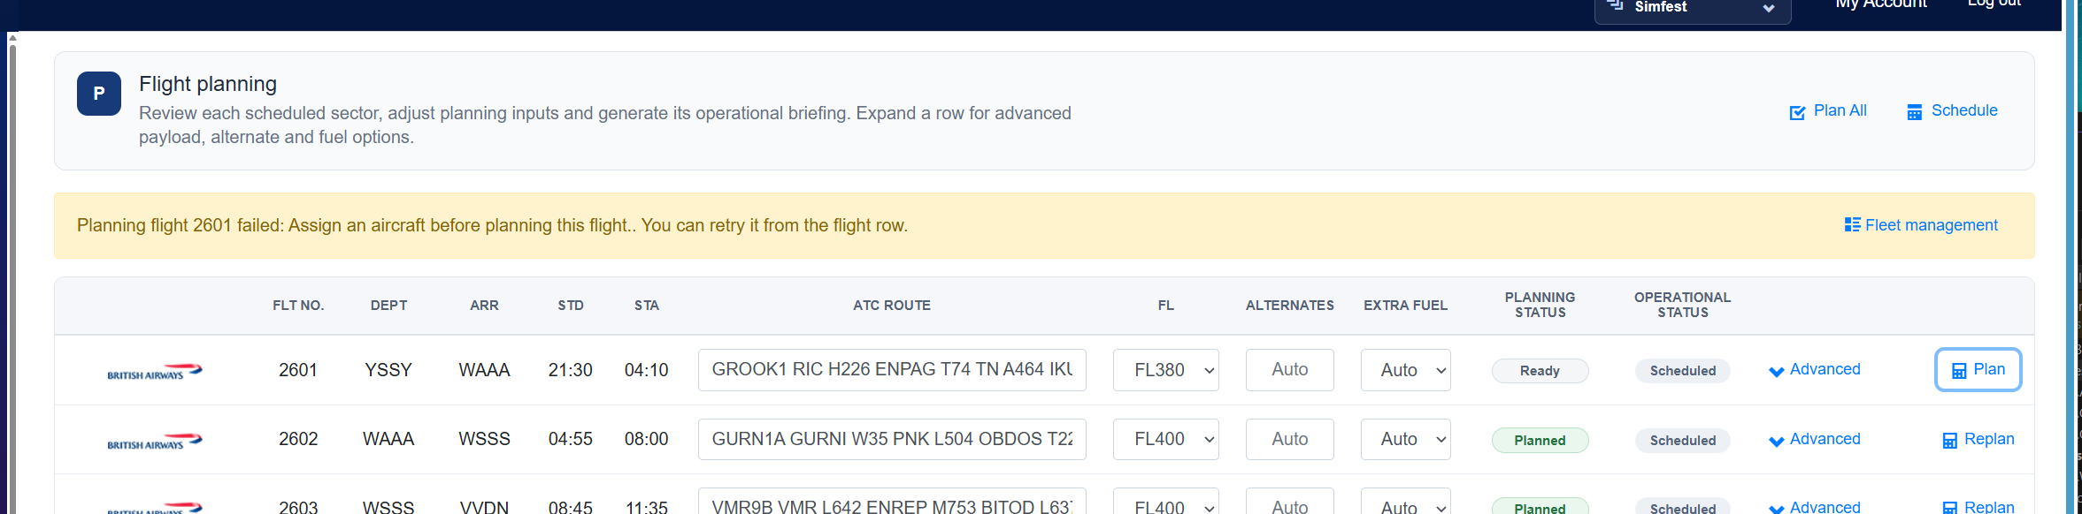
2. Schedule, assign and plan the flight
Planning and briefing
Check date, route and aircraft. Use Plan or Plan All, then review the briefing. Edit in SimBrief is in the briefing header. Recheck the stored plan before INIT DATA.
Earlier interface shown. Labels and layout may differ.
06
Notes:
Revision 6 September 2026. Sources: local MainForm.cs INIT DATA workflow; AircraftCustodyService.cs seven-day loans and file access; OperationsConsoleForm.cs workspace display; OrchestrationRuntime.cs authoritative turnaround. Earlier screenshots retained as labelled interface examples.

Slide 7
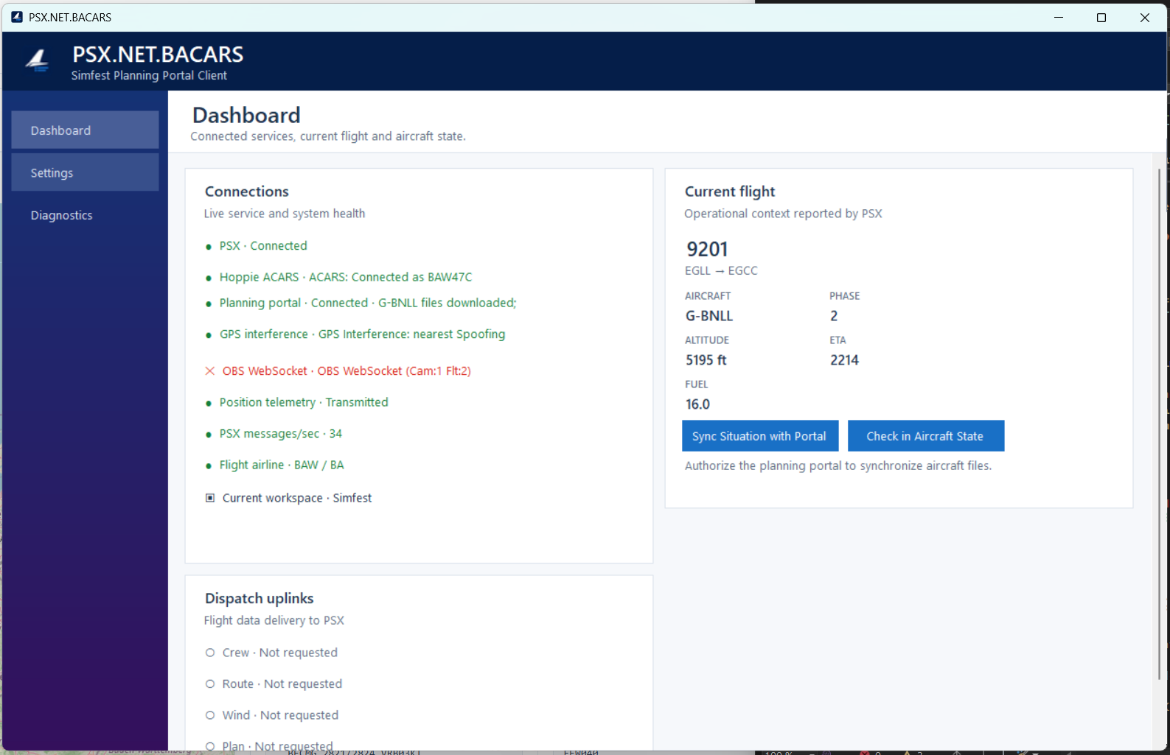
3. Authorise BACARS
BACARS follows the portal
Authorise the portal once, then check Current workspace on the Dashboard. PSX, Hoppie and Portal health remain visible while BACARS runs.
Earlier interface shown. Labels and layout may differ.
07
Notes:
Revision 6 September 2026. Sources: local MainForm.cs INIT DATA workflow; AircraftCustodyService.cs seven-day loans and file access; OperationsConsoleForm.cs workspace display; OrchestrationRuntime.cs authoritative turnaround. Earlier screenshots retained as labelled interface examples.

Slide 8
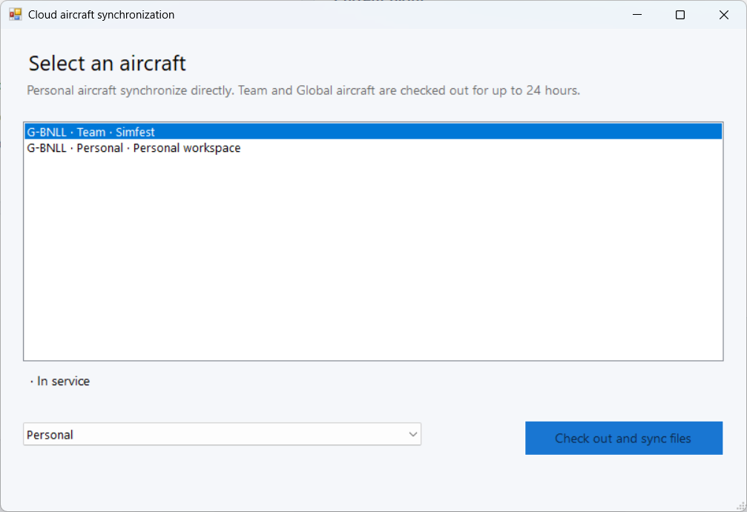
4. Synchronise the aircraft with PSX
Aircraft Synchronisation
Borrow Global Aircraft in the portal first. The loan lasts up to seven days. Refresh the list for the selected workspace. Team members can operate its active loans.
Earlier interface: ignore its 24-hour message. Borrow in the portal; Global loans last up to seven days.
08
Notes:
Revision 6 September 2026. Sources: local MainForm.cs INIT DATA workflow; AircraftCustodyService.cs seven-day loans and file access; OperationsConsoleForm.cs workspace display; OrchestrationRuntime.cs authoritative turnaround. Earlier screenshots retained as labelled interface examples.

Slide 9
5. INIT DATA REQ and turnaround
Crew
Assigned flight crew and names.
Route
Route and airline identity for the active flight.
Wind
PSX corridor winds converted from the stored OFP format.
Plan
Flight-plan and loadsheet data. Successful INIT DATA also requests departure turnaround.
Orchestration owns turnaround stages. Opening the apps alone does not start a cycle.
09
Notes:
Revision 6 September 2026. Sources: local MainForm.cs INIT DATA workflow; AircraftCustodyService.cs seven-day loans and file access; OperationsConsoleForm.cs workspace display; OrchestrationRuntime.cs authoritative turnaround. Earlier screenshots retained as labelled interface examples.

Slide 10
6. Flight and turnaround records
Live operation
BACARS supplies flight context. Orchestration controls ground-handling stages and readiness. Use the EFB for progress.
Final OOOI
A valid IN event marks the matching scheduled flight complete and stores its history.
One continuous history
Flights, location and Tech Log stay with the aircraft — including across global loans.
IN FLIGHT
ON COMPLETION
AIRCRAFT RECORD
10
Notes:
Revision 6 September 2026. Sources: local MainForm.cs INIT DATA workflow; AircraftCustodyService.cs seven-day loans and file access; OperationsConsoleForm.cs workspace display; OrchestrationRuntime.cs authoritative turnaround. Earlier screenshots retained as labelled interface examples.

Slide 11
7. Returning a borrowed global aircraft
SAVE
UPLOAD
RETURN
Save a fresh PSX situation
The new state must represent the aircraft after its operation.
Check in aircraft state
Upload through BACARS or the portal and confirm the final stand.
Return in the portal
State upload does not return the loan. Return clears unfinished assignments and preserves completed history.
11
Notes:
Revision 6 September 2026. Sources: local MainForm.cs INIT DATA workflow; AircraftCustodyService.cs seven-day loans and file access; OperationsConsoleForm.cs workspace display; OrchestrationRuntime.cs authoritative turnaround. Earlier screenshots retained as labelled interface examples.

Slide 12
If something is missing, check these first
Aircraft list
Check the current workspace. Reopen Aircraft Synchronisation.
Turnaround waiting
Check Orchestration, Auto mode, on-ground state and loaded flight context.
Files unavailable
Check model, situation, location and serviceability.
Cannot return
Upload a post-checkout situation and final stand.
12
Notes:
Revision 6 September 2026. Sources: local MainForm.cs INIT DATA workflow; AircraftCustodyService.cs seven-day loans and file access; OperationsConsoleForm.cs workspace display; OrchestrationRuntime.cs authoritative turnaround. Earlier screenshots retained as labelled interface examples.

Slide 13
SUMMARY
Planning and flying
with BACARS
Select workspace, plan and synchronise.
Use INIT DATA, then follow EFB stages.
Upload state and return Global loans.
Notes:
Revision 6 September 2026. Sources: local MainForm.cs INIT DATA workflow; AircraftCustodyService.cs seven-day loans and file access; OperationsConsoleForm.cs workspace display; OrchestrationRuntime.cs authoritative turnaround. Earlier screenshots retained as labelled interface examples.

